Slide 1
Quantification of the carbonation rate in an embankment after 34 years

Slide 2
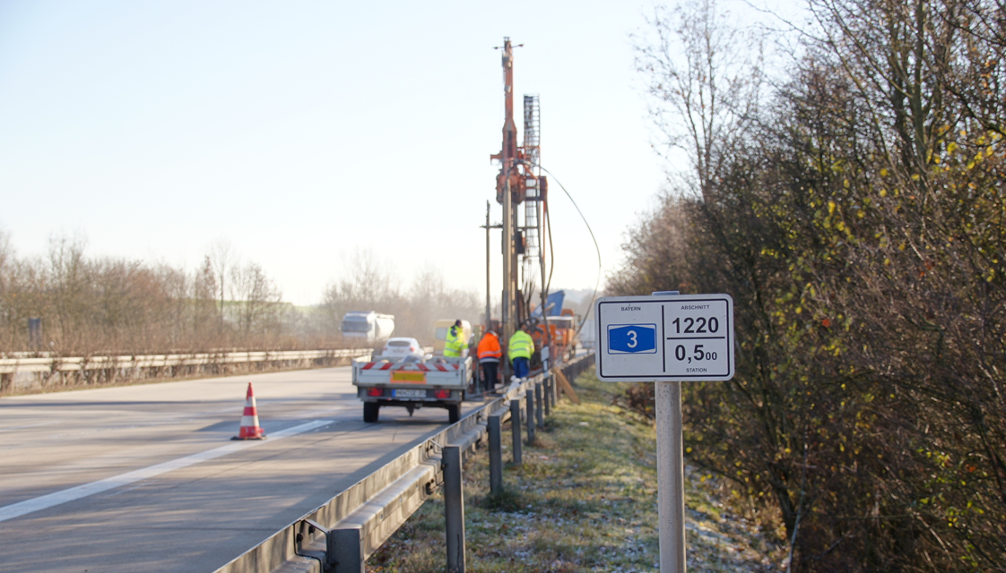
Soil improvement with quicklime Quantification of the carbonation rate in an embankment after 34 years
S. Haas, S. Hammerschmidt (Institute of lime and mortar research, Germany)
A. Shtiza (Industrial Minerals Association Europe, IMA-Europe, Belgium) Ch. Denayer (Carmeuse, Belgium) D. Scutt (Singleton Birch, United Kingdom)

Slide 3
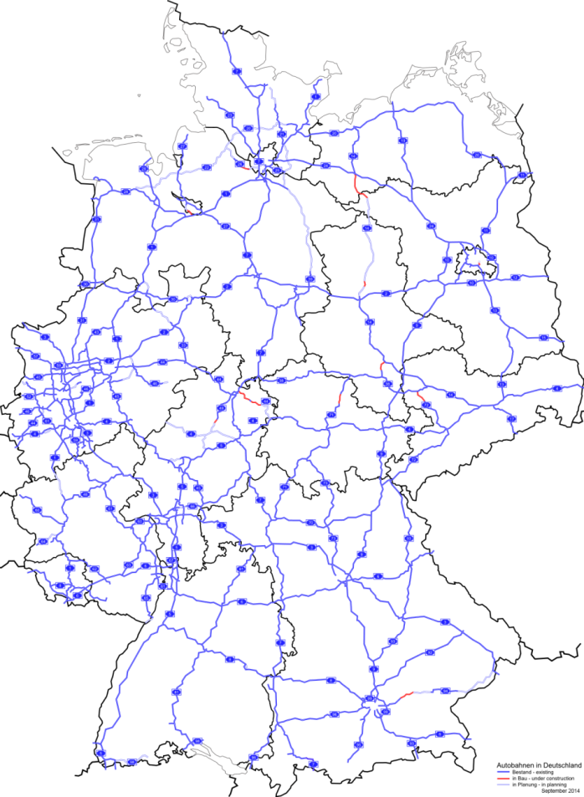
Quantification of the carbonation rate in an embankment after 34 years
Facts
Motorway A3 in South-Germany
Built in 1979
Embankment 10 m high
Built in layers
Soil treatment with lime
Varying lime dosages
Wikipedia, © BY 2.5
Source : BVK

Slide 4
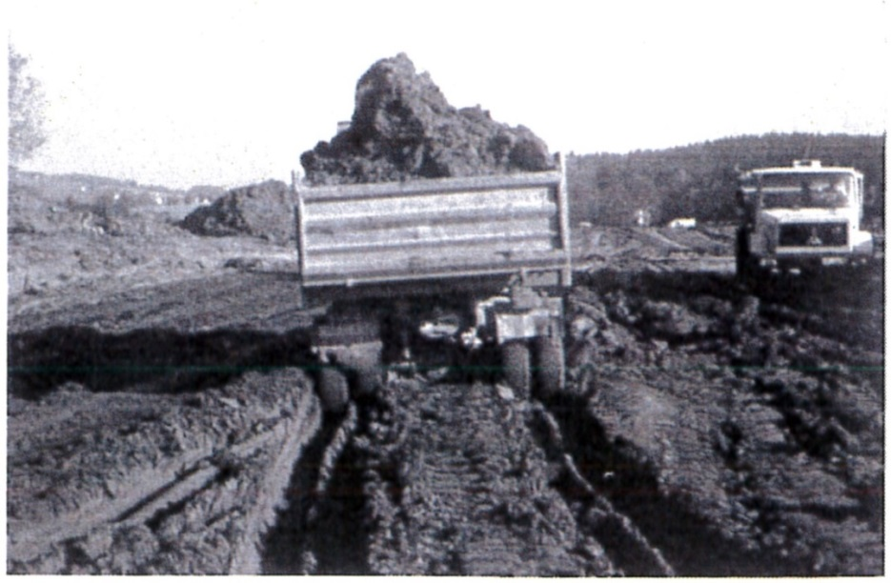
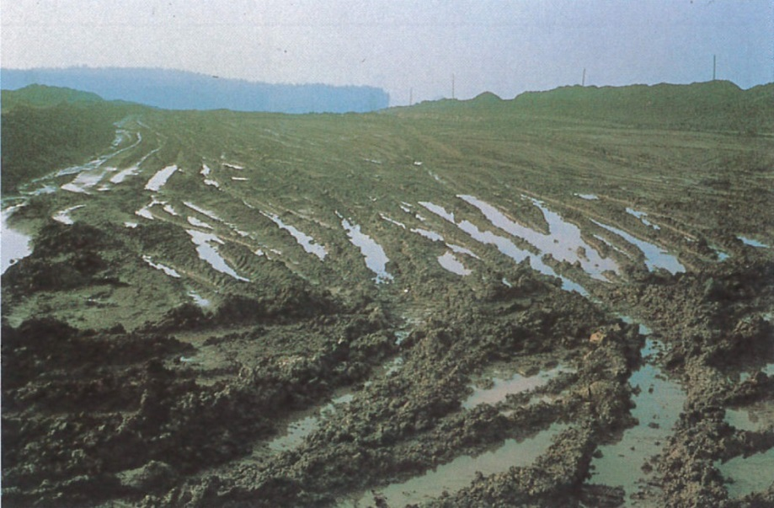
Soil improvement with quicklime
Initial Situation 1979
Soil:
Soft silt
Water-bearing sands
Coal-bearing clay
Embankment:
200.000 m³ excavated silt
> 20 % (w/w) water content
~ 2.5 % (w/w) Calcium-oxide
8500 t quicklime (CL 90 Q)
Source : BVK

Slide 5
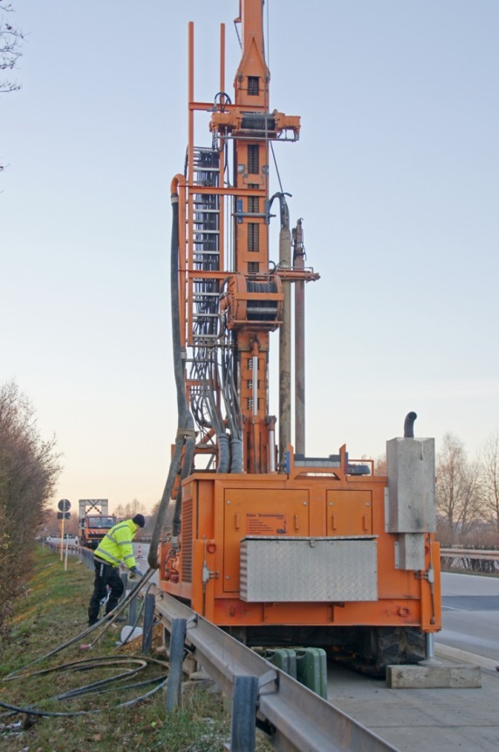
Soil improvement with quicklime
Drilling site
Sampling
1990 (11 years)
2013 (34 years)
Both studies
Compressive strength
Water content
2013 study
Chemical analyses
Drilling site 1990 & 2013
Source : BVK

Slide 6
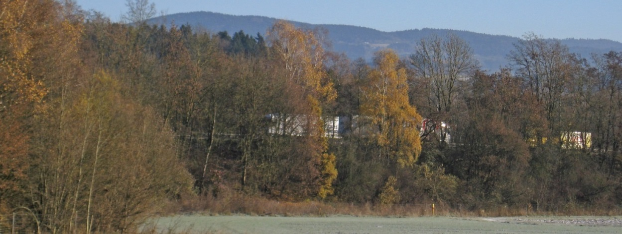
Soil improvement with quicklime
Embankment
Source : BVK

Slide 7
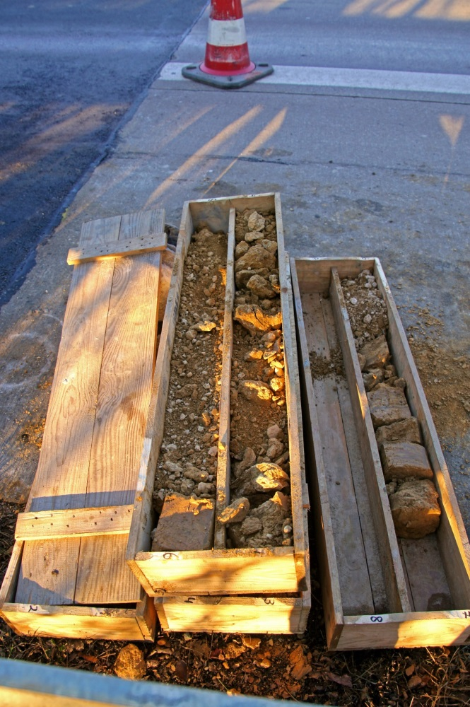
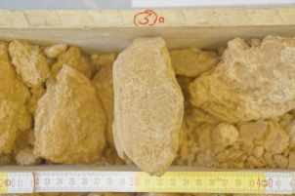
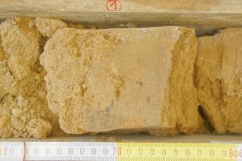
Soil improvement with quicklime
Sampling
Source : BVK

Slide 8
Soil improvement with quicklime
Reactions : problem statement
Ca(OH)₂
CSH
CaCO₃
CaO
Clay
Puzzolanic reactions
Distribution?
CO₂
Carbonation
Source : BVK

Slide 9
Soil improvement with quicklime
Reaction quantification (mean values)
Source : BVK

Slide 10
Soil improvement with quicklime
Carbon footprint of quick lime – CL90Q
Check the numbers
Based on Best-Available-Technique
Life Cycle Inventory
LCI _{EuLA2015} = 1.170 kg/T
Peer Review
Downloadable @ GABI
New LCI under construction
Carbonation rate
40% _{EuLA – S.Haas & All} = 0.314 kg/T
LCI _{CL90-Q soil stab} = 0.856 kg/T
Source: Carmeuse estimate – based of PFR-kilns – CL90Q-high purity

Slide 11
Soil improvement with quicklime
Initiatives on-going : Net Zero Carbon Industry by 2050
Check the numbers
A lot of initiatives on-going on …
Carbon Capture Utilization
Carbon Capture Storage
CO2/T lime
2022
2030
2050
Source: Carmeuse estimate – own assumptions

