Slide 1
SUSTAINABLE LOOK
ON GEOTECHNICS
III. ViaCalco Symposium
in BME
Budapest, 2022

Slide 2

Sustainable look on Geotechnics
2
Setting the scene
Historical evolutions
New : Waterways & dikes
Sustainability
AGENDA

Slide 3
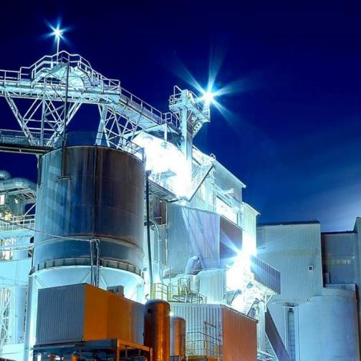
CARMEUSE IN A SNAPSHOT
Turnover 2021
EUR 1.4 billion
Number of employees
+/- 4,500
Tonne of lime delivered
to customers per year
+/- 9 million
Number of plants
around the world
90
Number of limestone quarries around the world
60
Number of customer
sites served globally
12,700

Slide 4
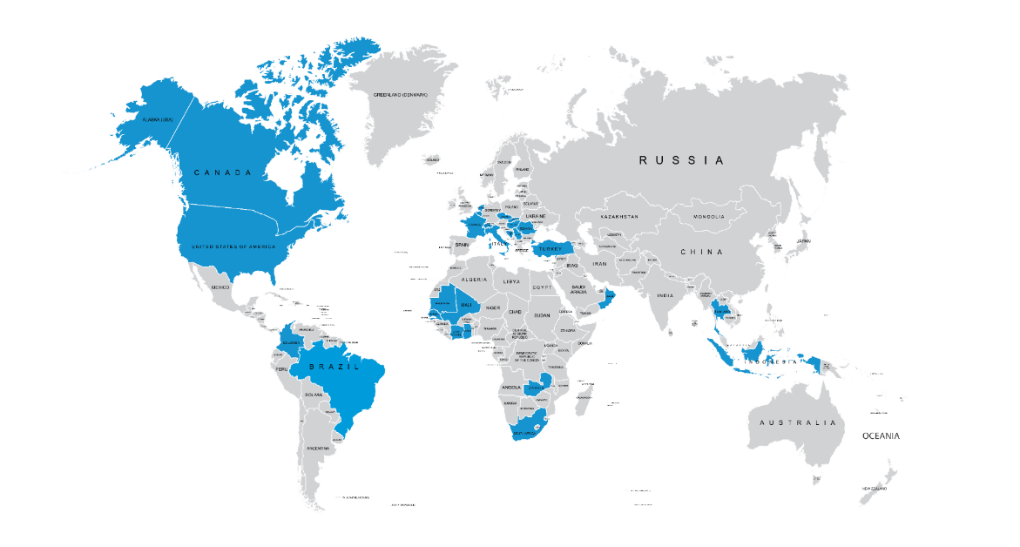
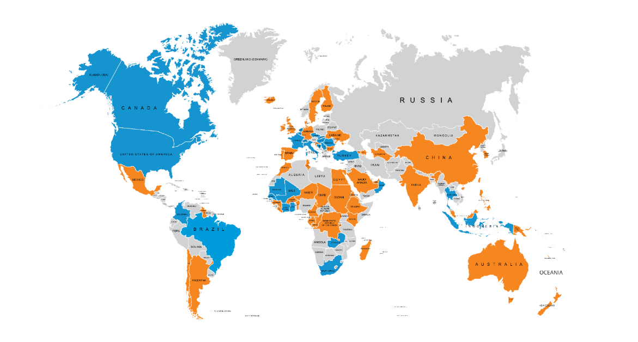
WE ARE A GLOBAL LEADER
Carmeuse locations
Countries customers

Slide 5
RECENT ACQUISITIONS
2016
2017
2018
2019
2020
2021
2022
SEP
JUN
MAR
FEB
FEB
MAR
FEB
GOLDEN LIME
THAILAND
STT
CANADA
SARABURI QUICKLIME
THAILAND
YAGER
US
OHIO RIVER AGGREGATES
US
SOCHA
TUNISIA
GREEN FIELD
SENEGAL
DEC
MAR
MAR
AUG
OXIDOS
BRAZIL
HURON LIME
US
CAL ARCO IRIS
BRAZIL
FEB
LINWOOD
US
TENERA
HQ
MAY
MAR
SEP
MINTEK
US
UNICALCE
(additional shares)
ITALY
APR
JONICK DOCK
US
THAI MARBLE
CMEA
DEC
APR
SCHLEGEL SAND AND GRAVEL
US
CHEMLIME
US
JUN
AGROFORCE
HUNGARY

Slide 6
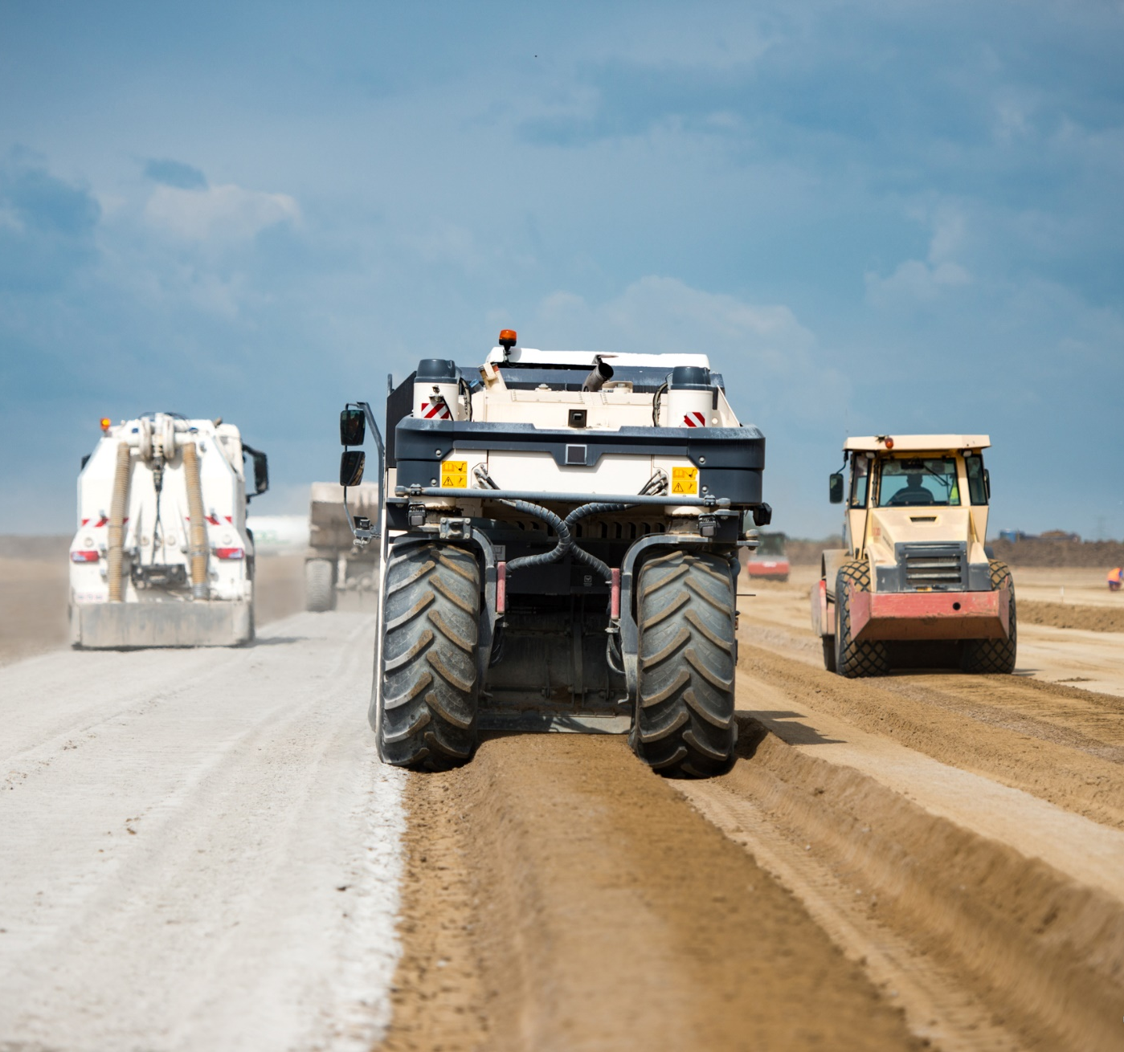
MARKETS
36%
IRON & STEEL
14%
CIVIL ENGINEERING
10%
FLUE GAS CLEANING
9%
BUILDING MATERIALS
6%
WATER & WASTE TREATMENT
6%
CHEMICAL
6%
NON-FERROUS
4%
AGRICULTURE
4%
PCC AND PULP & PAPER
2%
GLASS

Slide 7
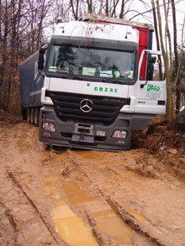
VIACALCO – Poor rated soils can be transformed into part of embankments, replacing aggregates solutions
MARGINAL SOILS - a major challenge
“Poor rated”​
Difficult for geo-engineers
Soil Treated Layers
For capping layers, subgrade & fills
Marginal soils​

Slide 8
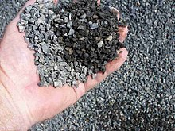

Sustainable look on Geotechnics
EARTHWORKS - a challenge for designers & investors
Positioning soil treatment versus aggregates
TRADITIONAL
METHOD
SOIL
TREATMENT
Use of quarry-aggregates
Reuse of in-situ soil with binders

Slide 9
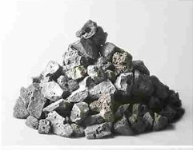

Sustainable look on Geotechnics
Landscaping
TRADITIONAL
METHOD
Landfilling
Identification of railway-track or road
Identification of overburden
Removal of soil = LANDFILLING
Purchase of aggregates
Transport aggregates + compaction
Quarry

Slide 10
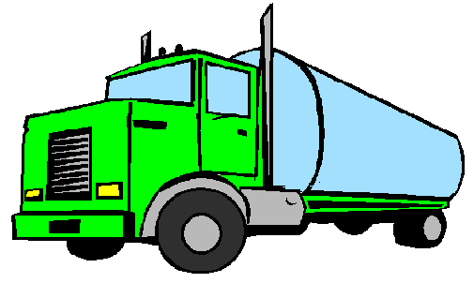
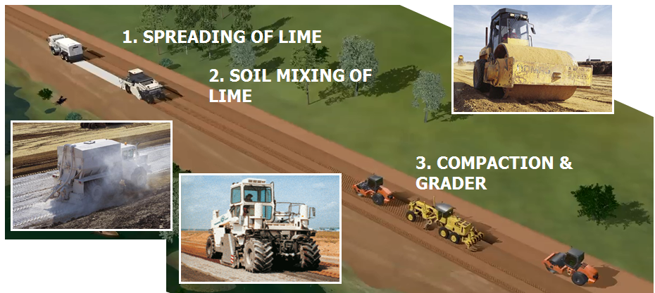
Sustainable look on Geotechnics
SOIL
TREATMENT
Landscaping
Identification of rail track or road
Soil analysis of overburden
Purchase of lime
Soil transport on-site
Soil mixing & compaction
ViaCalco

Slide 11
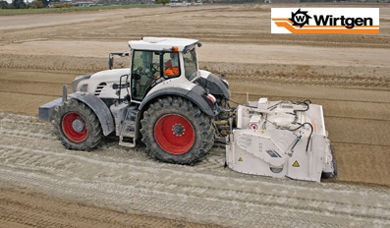
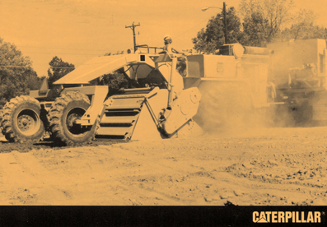
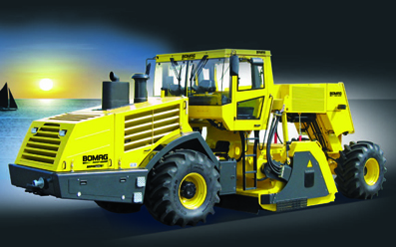
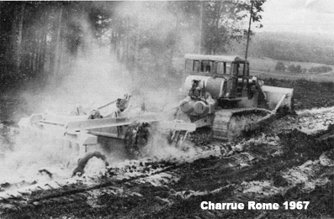
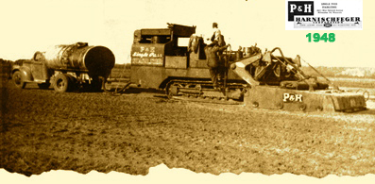
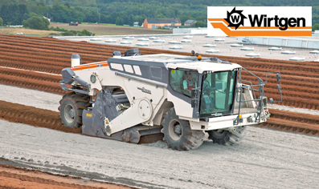
Sustainable look on Geotechnics
Evolution Soil Mixing Equipment – made it happen
ACTUAL &
MODERN TECHNOLOGY
1948
1967
1980
1990
2000 – always better, more performant

Slide 12
Sustainable look on Geotechnics
Historical evolution - Europe
1904
First Use in America –> US Army
1960
Highways France
Central Europe => after 2000
1990
High Speed Railway
2000
Airports, industrial areas, …
2024
Waterways & dikes
Notes:
1904-1960
First use in USA (1904)
Understanding of lime & clay soils (swelling) in 1940’s
1956 : Lime Fixation Point (by US-Army) – “STABILISATION”
1960’s
First use in France
1970-1990
Highway projects Belgium
1200 km built
First use – limited
15 million m3
200.000 T lime used (*)
1990-1996
High Speed Railway Paris-Lille-Calais
1997-2006
High Speed Railway Belgium
300 km built
Know-how progressed (SNCF)
15 million m3
300.000 T lime used (**)
2000-today
Flemish Law : Gronddecreet (1995)
More & more soil mixing technology available (Wirtgen becoming the reference)
French laws (recycling promoted)
Use for industrial parks, conventional railways, roads, airports, …
Evolution of Nat. Technical Guides
Walloon Law (2020) : Walterre
2019-2020
Turkey
Largest megaproject Carmeuse
Highway connection to Canakkale-Bridge
100 km (in 2Y built)
10 million m3
250.000 T
FUTURE
Always larger megasized earthworks projects
Canal-Seine-Nord
Carbon reduction solutions in the picture

Slide 13
Sustainable look on Geotechnics
Debrecen
Always supply to larger sized mega-projects
  Blends
Highway : Gelibolu-project TR
300.000 T in 2Y
Size | Tons/Project
L | >1.000
XL | >10.000
XXL | >100.000
3XL | >1.000.000
KT/Y
Start soil stab in Central EU
Canal-Seine-Nord
As know-how evolved: L – XL – XXL => Know-how = “Code of Good Practice”

Slide 14
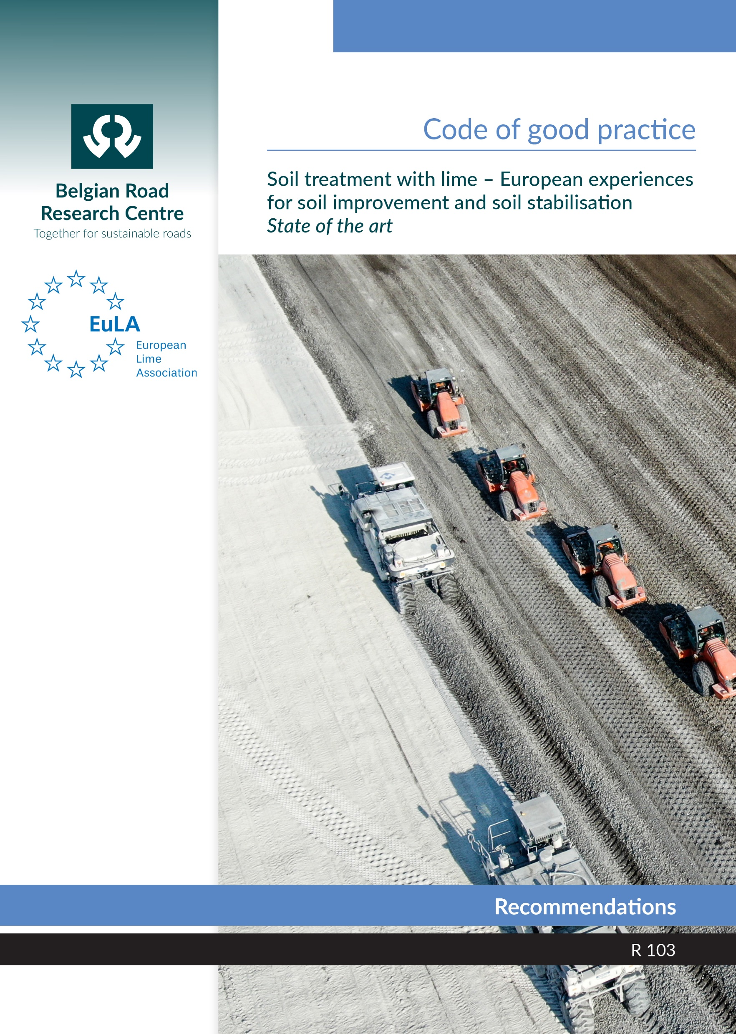
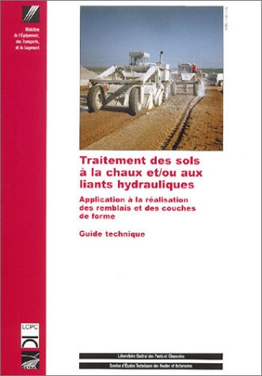
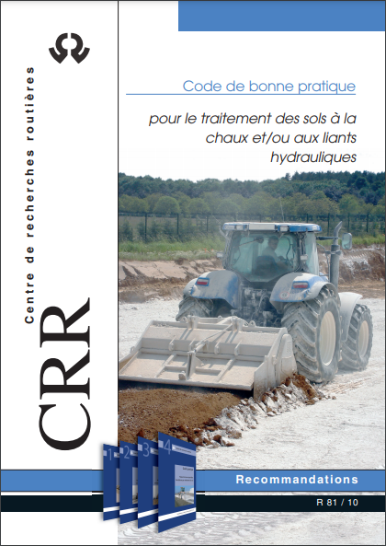
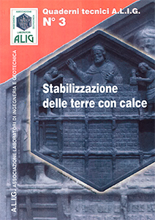
Sustainable look on Geotechnics
Know-how: Codes of Good Practice
Continuous evolution

Slide 15
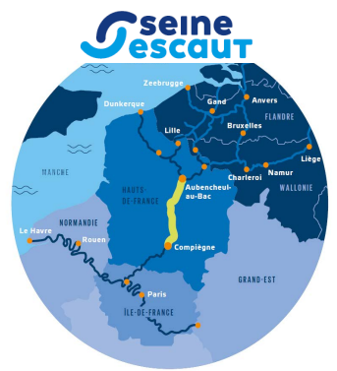
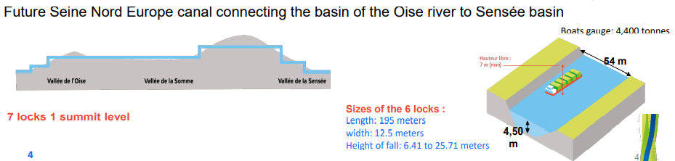
Sustainable look on Geotechnics
Canal-Seine-Nord-Escaut: connection of Paris region
Mega-Project – starting soon – experimental sites on-going
106 km
Test Basin
(waterproofing)
Source : Canal Seine Nord

Slide 16
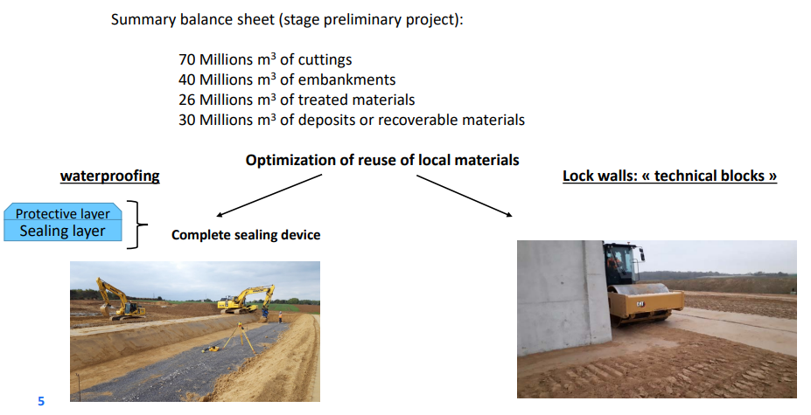
Sustainable look on Geotechnics
Mega-sized earthworks project
Execution on-going (just started => earthworks till 2027)
70 Millions m³
(4 years of earthworks)
Source : A. Mehenni & All - Canal Seine Nord & Bouygues – 5th Internal Seminar on Earthworks Europe (2022)

Slide 17
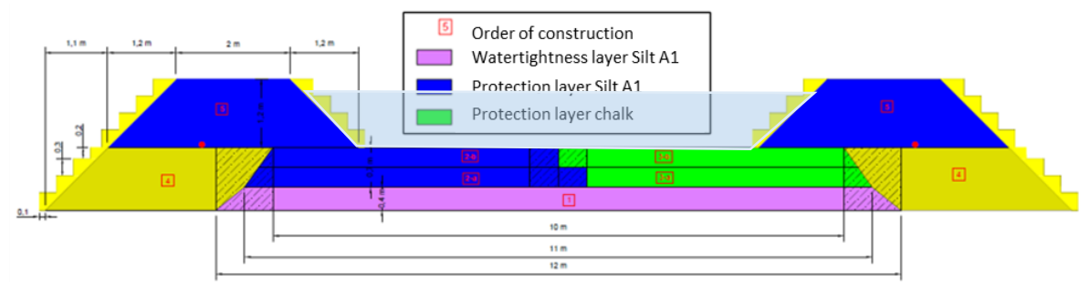
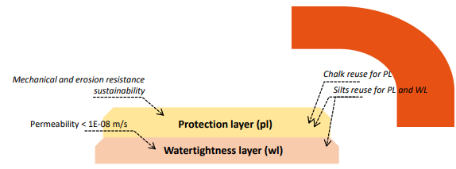
Sustainable look on Geotechnics
Test Basin - design
Source : A. Mehenni & All - Canal Seine Nord & Bouygues – 5th Internal Seminar on Earthworks Europe (2022)

Slide 18
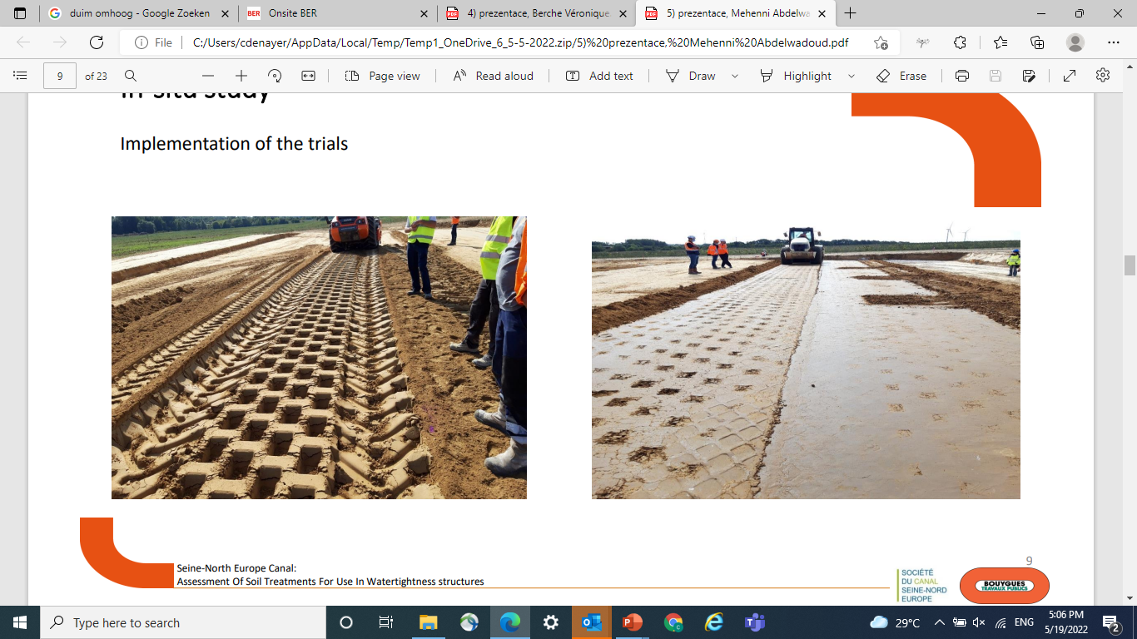
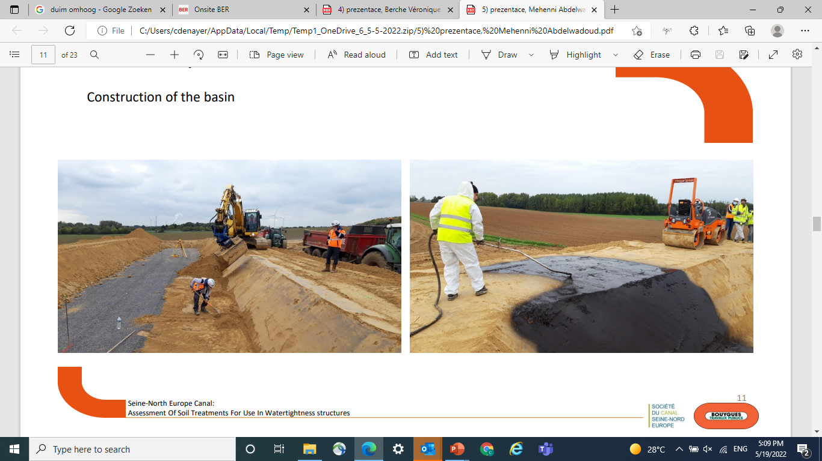
Sustainable look on Geotechnics
Test Basin - construction
Source : A. Mehenni & All - Canal Seine Nord & Bouygues – 5th Internal Seminar on Earthworks Europe (2022)

Slide 19
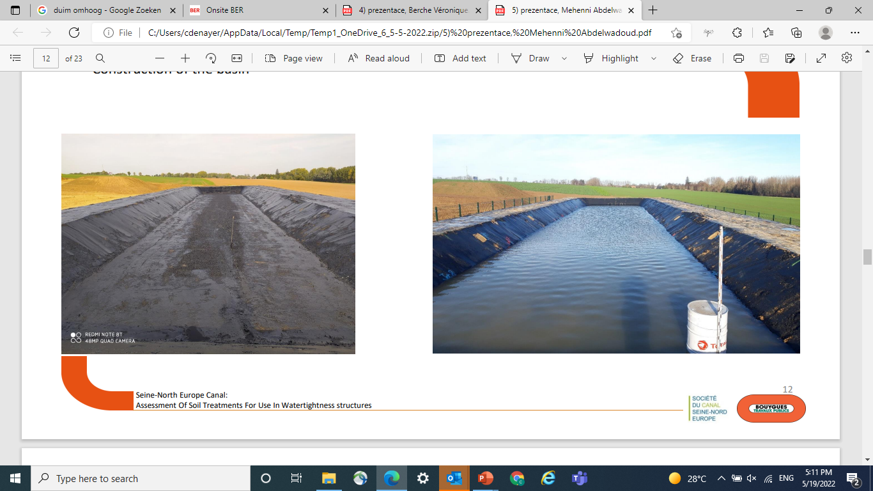
Sustainable look on Geotechnics
Test Basin - finished
Source : A. Mehenni & All - Canal Seine Nord & Bouygues – 5th Internal Seminar on Earthworks Europe (2022)

Slide 20
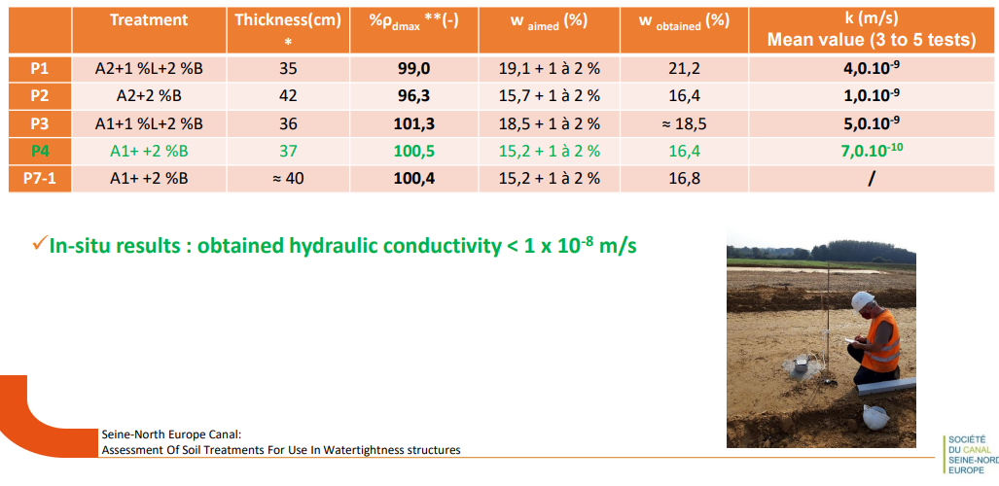
Sustainable look on Geotechnics
Watertightness layer
Hydraulic conductivity < 1 x 10⁻⁸ m/s
Source : A. Mehenni & All - Canal Seine Nord & Bouygues – 5th Internal Seminar on Earthworks Europe (2022)

Slide 21
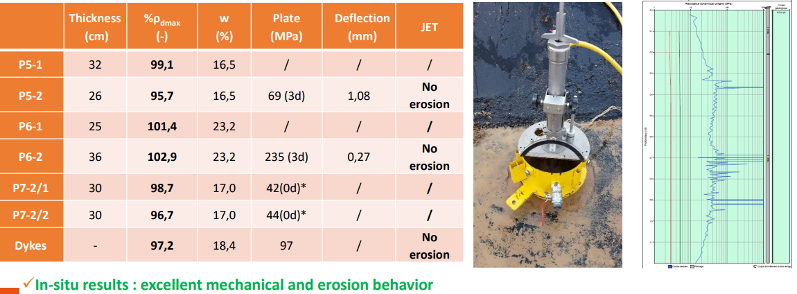
Sustainable look on Geotechnics
Results Protection Layer
In-situ
Source : A. Mehenni & All - Canal Seine Nord & Bouygues – 5th Internal Seminar on Earthworks Europe (2022)

Slide 22
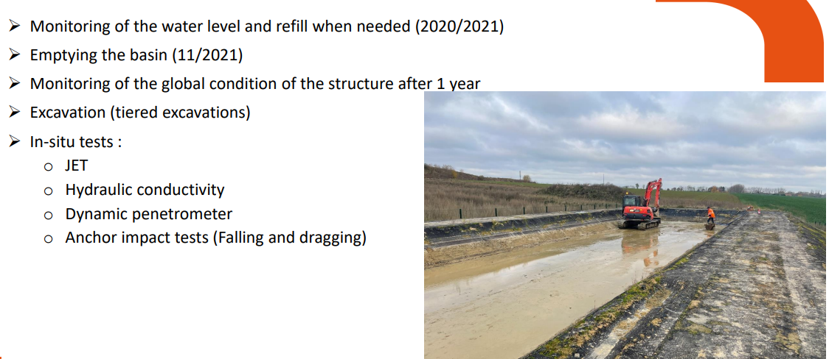
Sustainable look on Geotechnics
Test Basin - after 1 year under water
Source : A. Mehenni & All - Canal Seine Nord & Bouygues – 5th Internal Seminar on Earthworks Europe (2022)

Slide 23
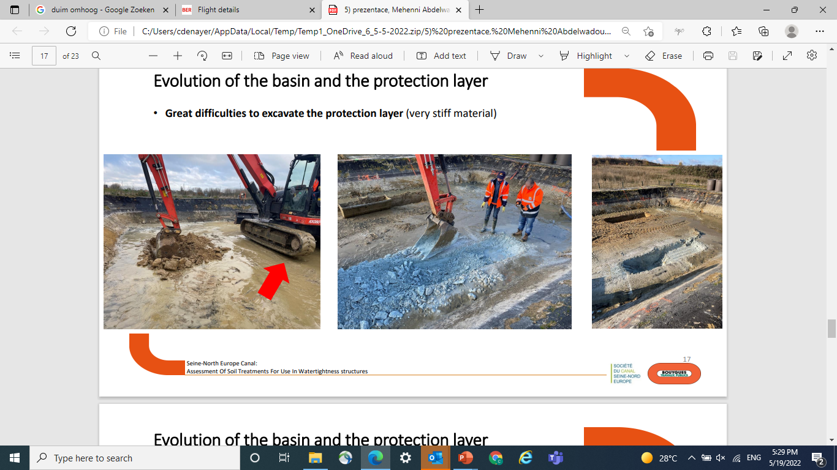
Sustainable look on Geotechnics
Evolution of the Test Basin
Great difficulties to excavate the Protection Layer (very stiff material)
Source : A. Mehenni & All - Canal Seine Nord & Bouygues – 5th Internal Seminar on Earthworks Europe (2022)

Slide 24
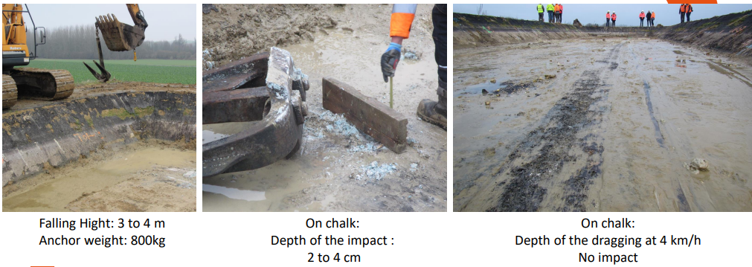
Sustainable look on Geotechnics
Anchor Falling Test
Source : A. Mehenni & All - Canal Seine Nord & Bouygues – 5th Internal Seminar on Earthworks Europe (2022)

Slide 25
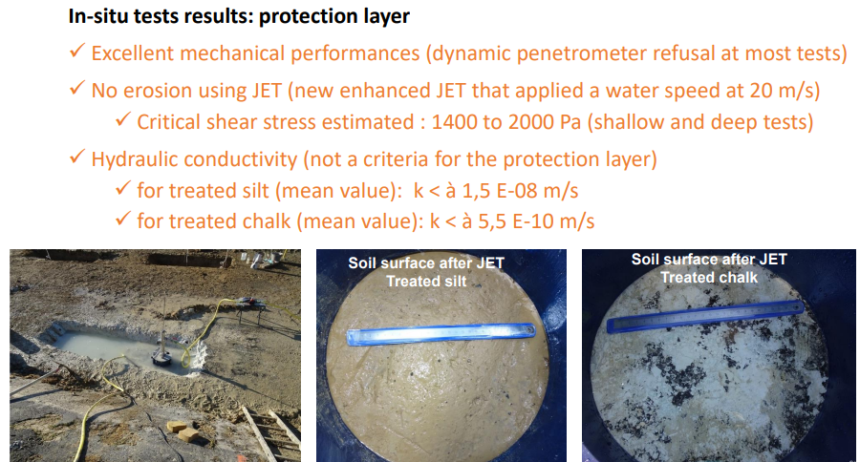
Sustainable look on Geotechnics
Evolution of the basin and the protection layer
Source : A. Mehenni & All - Canal Seine Nord & Bouygues – 5th Internal Seminar on Earthworks Europe (2022)

Slide 26
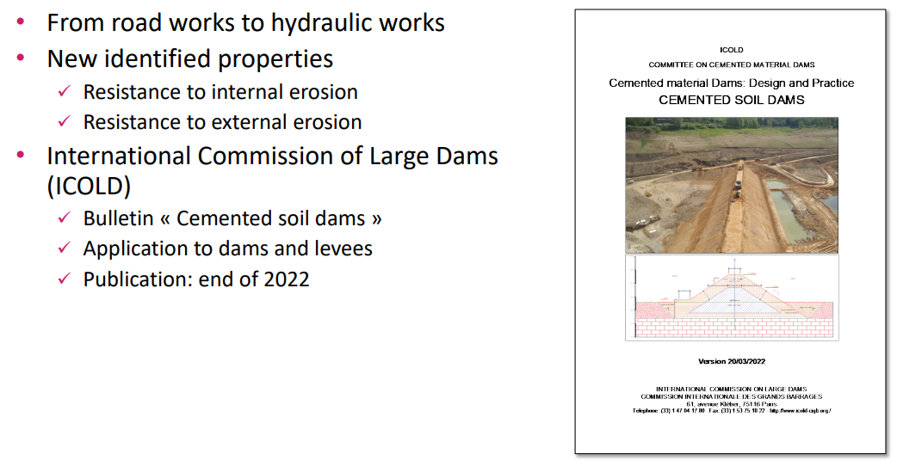
Sustainable look on Geotechnics
Cemented Soil Dams – soon available
ICOLD

Slide 27

Sustainable look on Geotechnics
A sustainable, future proof solution
  Saving natural resources, execution time & money
EU - Green Public Procurement Approved
Avoid landfilling, and footprint of.
Saves natural resources : reduced need of aggregates
Resource Efficient
More Safety and well-being
Highly reduced site traffic, increased safety and less accidents
High reduction of road traffic, less hinderance for neighbors
Reduced need in quarry materials
Reduced supply chain costs
Reduced landfilling costs and landfillling tax costs
Reduced cost
Dries up wet sites, creating access, and extends working time
Very high pace feasible for small, large, and mega-projects
Ease of execution and control
Reduced ccnstruction time

Slide 28
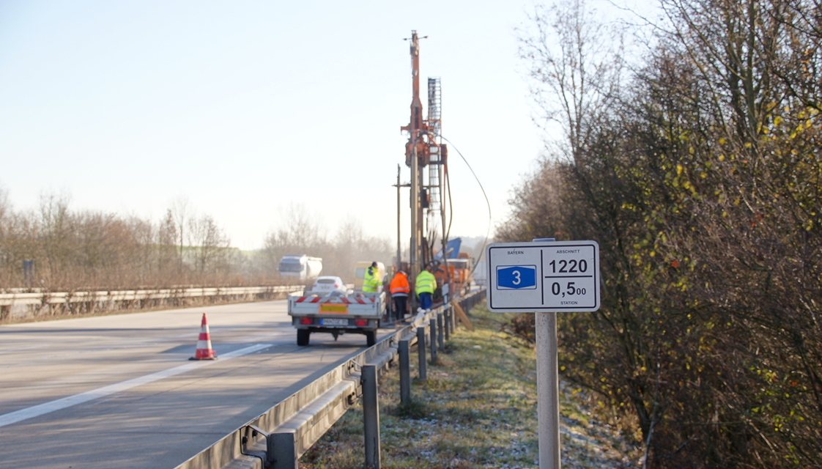
Soil improvement with quicklime
Quantification of the carbonation rate in an embankment after 34 years
S. Haas, S. Hammerschmidt (Institute of lime and mortar research, Germany)
A. Shtiza (Industrial Minerals Association Europe, IMA-Europe, Belgium)
Ch. Denayer (Carmeuse, Belgium)
D. Scutt (Singleton Birch, United Kingdom)

Slide 29
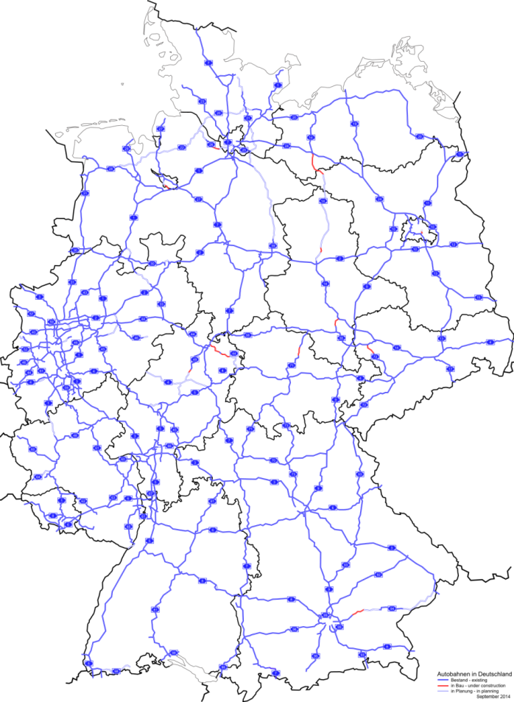
Facts
Motorway A3 in South-Germany
Built in 1979
Embankment 10 m high
Built in layers
Soil treatment with lime
Varying lime dosages
Wikipedia, © BY 2.5

Slide 30
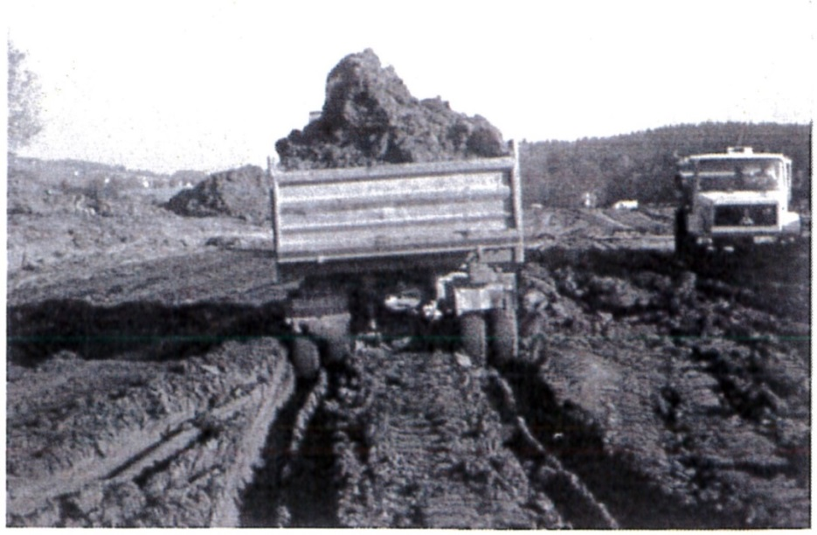
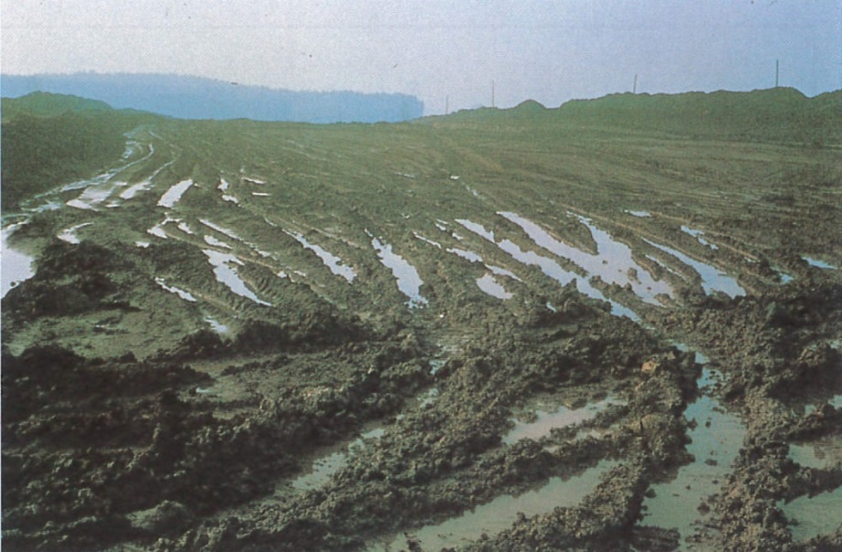
Initial Situation1979
Soil:
  Soft silt
  Water-bearing sands
  Coal-bearing clay
Embankment:
  200.000 m³ excavated silt
  > 20 % (w/w) water content
  ~ 2.5 % (w/w) Calciumoxide
  8500 t quicklime (CL 90 Q)

Slide 31
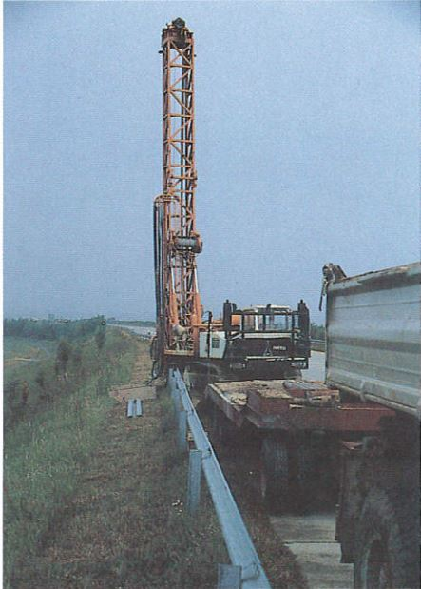
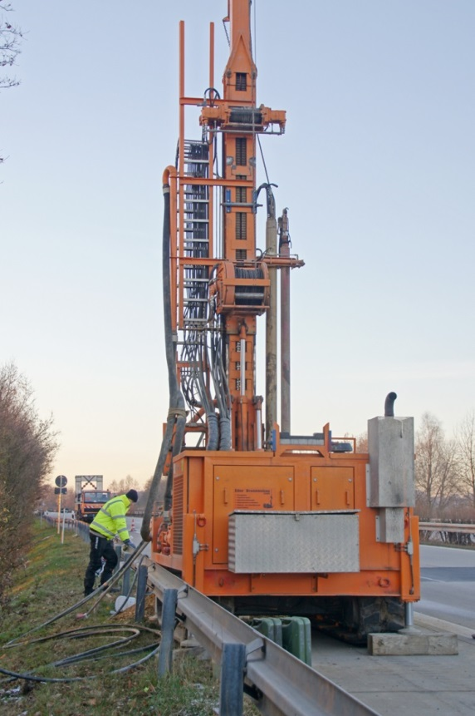
Drilling site
Sampling
  1990 (11 years)
  2013 (34 years)
Both studies
  Compressive strength
  Water content
2013 study
  Chemical analyses
Drilling site 1990 & 2013
Notes:
same location -> direct comparison possible

Slide 32
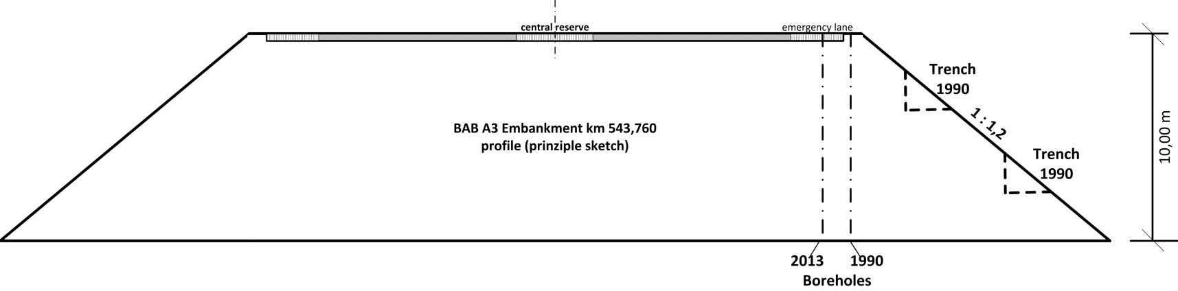
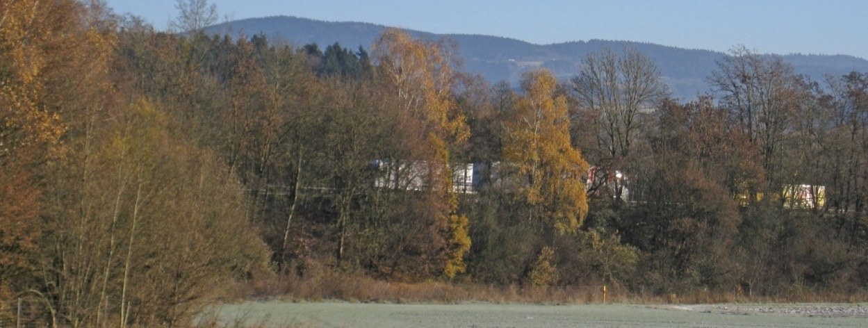
Embankment

Slide 33
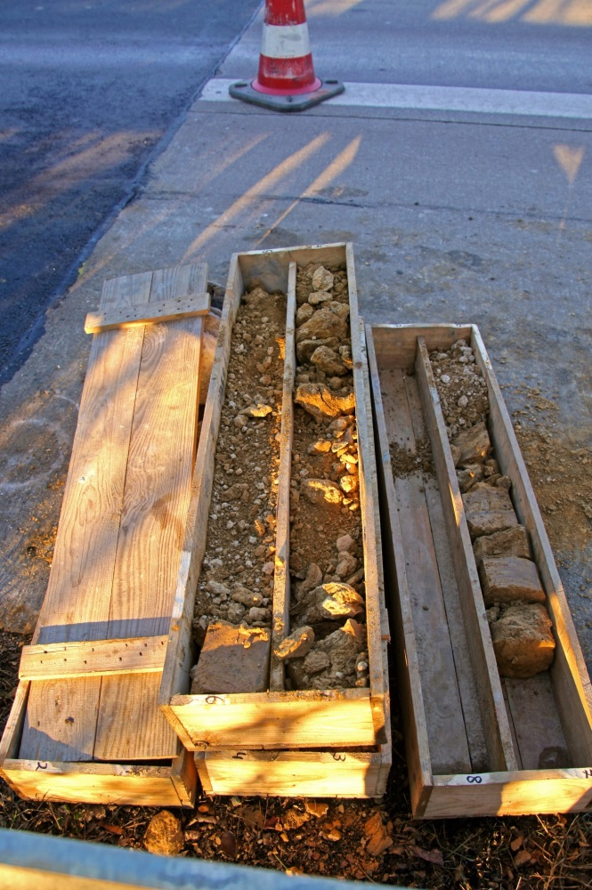
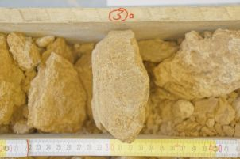
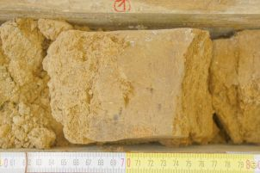
Sampling

Slide 34
Reactions : problem statement
Ca(OH)₂
CSH
CaCO₃
CaO
Clay
Puzzolanic reactions
Distribution?
CO₂
Carbonation

Slide 35
Reaction quantification (mean values)
Source : BVK

Slide 36
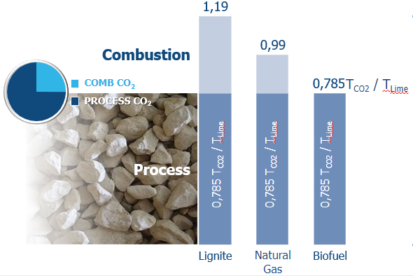
Carbon footprint of quick lime – CL90Q
Based on Best-Available-Technique
Life Cycle Inventory
LCI _{EuLA2015} = 1.170 kg/T
  Peer Review
  Downloadable @ GABI
  New LCI under construction
Carbonation rate
40% _{EuLA – S.Haas & All} = 0.314 kg/T
LCI _{CL90-Q soil stab} = 0.856 kg/T
Source: Carmeuse estimate – based of PFR-kilns – CL90Q-high purity

Slide 37
Initiatives on-going : Net Zero Carbon Industry by 2050
A lot of initiatives on-going on …
Carbon Capture Utilization
Carbon Capture Storage
CO2/T lime
2022
2030
2050
VIP meeting
Source: Carmeuse estimate – own assumptions

Slide 38
THANK YOU

